Slide 1
Polarity
PowerPoint presentation
Unit 304: Electrical Installations: inspection, testing and commissioning

Slide 2
Polarity
This test must be carried out to verify that:
every fuse and single‑pole control and protective device is connected in the line conductor only, and
except for E14 and E27 lampholders to BS EN 60238, in circuits having an earthed neutral conductor, centre contact bayonet and Edison screw lampholders have the outer or screwed contacts connected to the neutral conductor, and
wiring has been correctly connected to socket outlets and similar accessories.

Slide 3
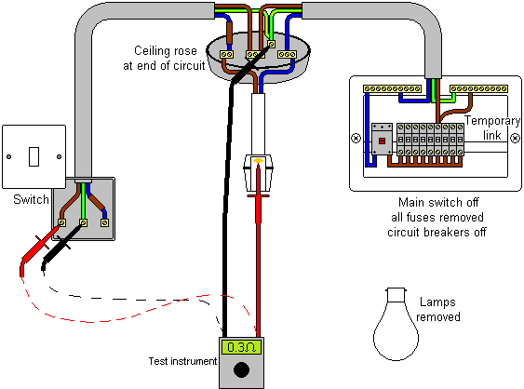
Polarity
It is only necessary to confirm polarity; there is no necessity to record a value. In other words, it is a ‘GO’ or ‘NO‑GO’ test.

Slide 4
Any questions?

